Slide 1
SEI Diabetes Monitoring
Ishaq Khan

Slide 2

Introduction
SEI Diabetes Monitoring
Founding Members – Physician, Pharmacist, IT Analyst
Outpatient clinic focused on the prevention and management of diabetes in the community

Slide 3

Background
Diabetes
Definition
Types
Type 1
Type 2 – Focus of SEI Monitoring
Gestational
Symptoms
Diagnosis
Treatments

Slide 4
Background
Population Statistics
United States – 340 million individuals
Diabetic – 37.8 million
69% report hypertension
12% report vision impairment
Prediabetic – 96 million
Centers for Disease Control and Prevention. National Diabetes Statistics Report website. https://www.cdc.gov/diabetes/data/statistics-report/index.html. Accessed 3 October 2023.
United States Population (2023). https://worldpopulationreview.com/countries/united-states-population. Accessed 6 October 2023.

Slide 5

Design of BI System
Transactions of Interest
Initial patient encounter
Follow-up patient encounter
Measurements of Interest
A1C level
Blood Pressure
Diabetic Eye and Foot Exam Scores
Business Decisions
Targeted Patient Population
Type of Intervention
Frequency of Follow-up Visits

Slide 6
Design of BI System
Transactional Database Design with Defined Attributes and Entities

Slide 7
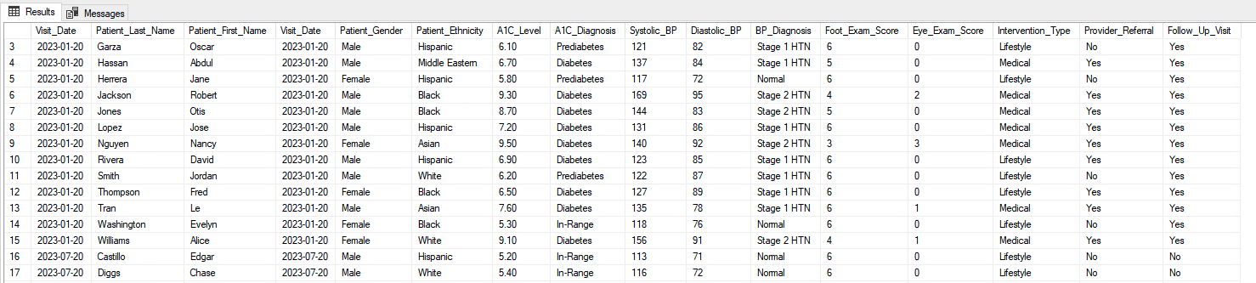
Data Entry Snapshot

Slide 8
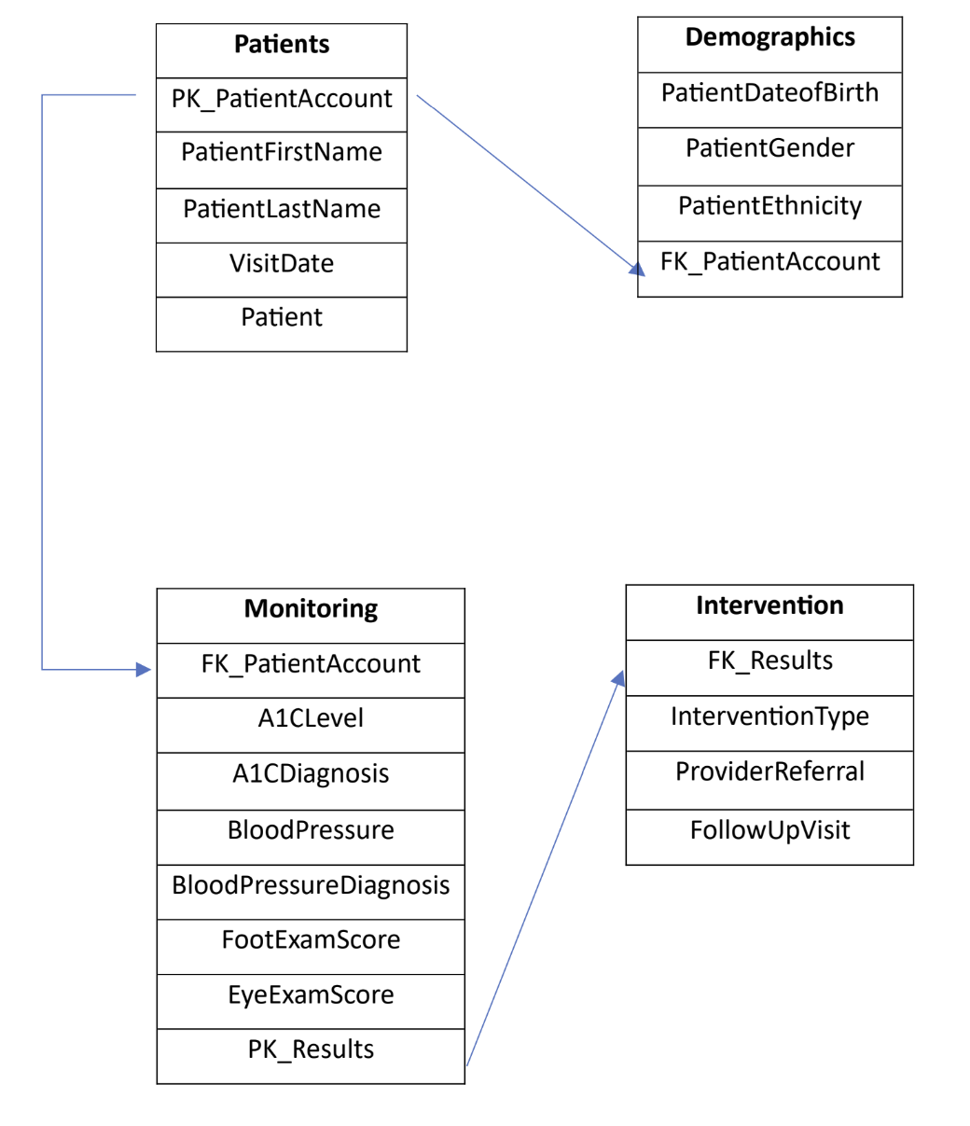
Entity-Relationship Diagram
Entity Relationship diagram shows the design of each table/entity and their relationship.
Primary Keys(labeled “FK”) and Foreign Keys (labeled “PK”) are placed to indicate which entity will work with another table, using arrows displaying the relationships between the tables.

Slide 9
Data Mart
Subset of a data warehouse that focuses on a specific area within an organization.
Target of Interest:
A1C level
Blood Pressure
Diabetic Eye and Foot Exam Scores

Slide 10
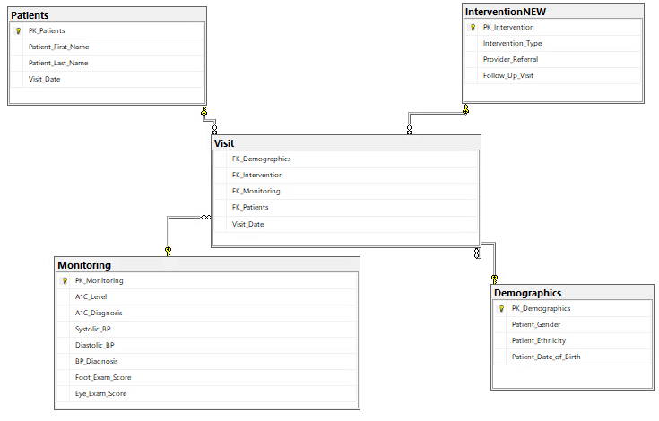
Central Fact/Dimension Table
Star Schema with tables and their relationships.
Includes the facts attributes and Foreign Keys (labeled “FK”).
“Visit” is the fact table.
“Patient”, “InterventionNEW”, “Monitoring”, and “Demographic” Tables are our Dimension Tables.

Slide 11
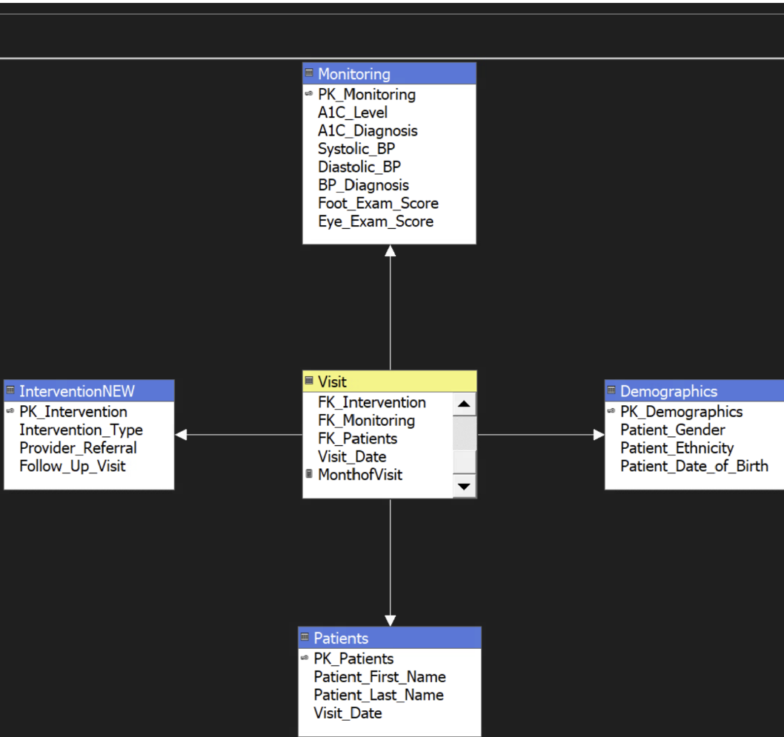
Cube Design
Online Analytical Processing (OLAP) cube is represented in a star schema that includes the date hierarchy.
Presents the data in a meaningful presentation displaying all measures, dimensions, and hierarchy.

Slide 12
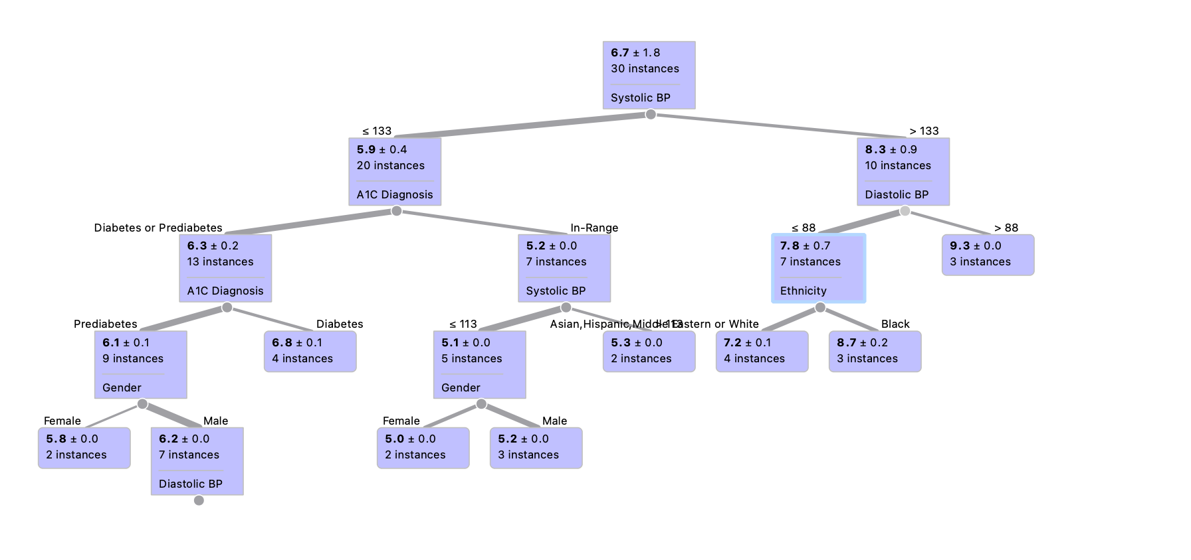
Decision Tree

Slide 13
Conclusions
Black ethnicity likely to have highest A1C levels
Lifestyle changes for prediabetics is key, kept them prediabetic
Blood pressure management played role in maintaining lower A1C levels
Frequency of follow-up visits should be more than 6 months

